Slide 1

As Rockbuster company planning to launch an online video rental service, so we prepared an analysis to answer basic questions about 2020 company strategy

Slide 2

How are customers distributed geographically and where do our top revenues come from?
Where do our top customers come from?
What are our favorite categories, the one that make the highest revenue?

Slide 3
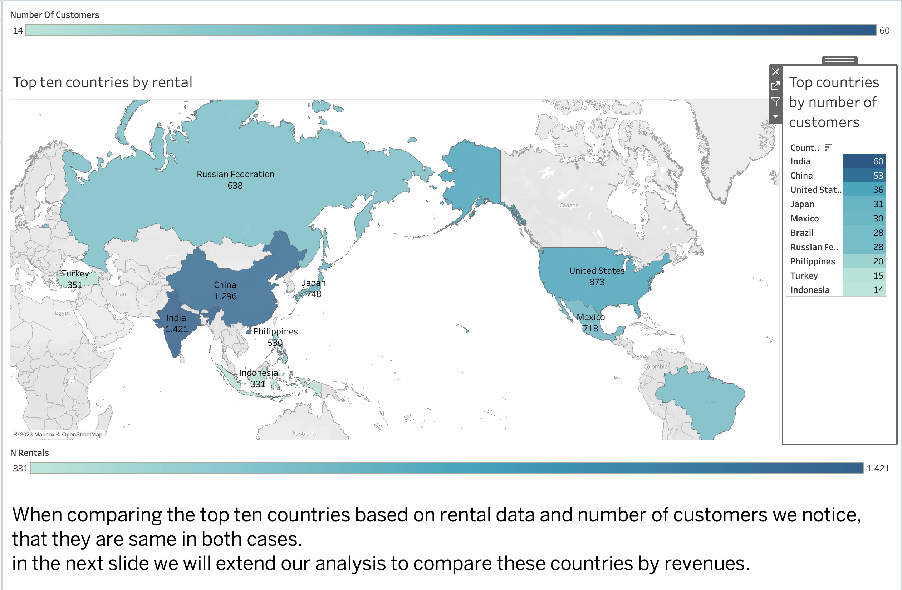

Slide 4
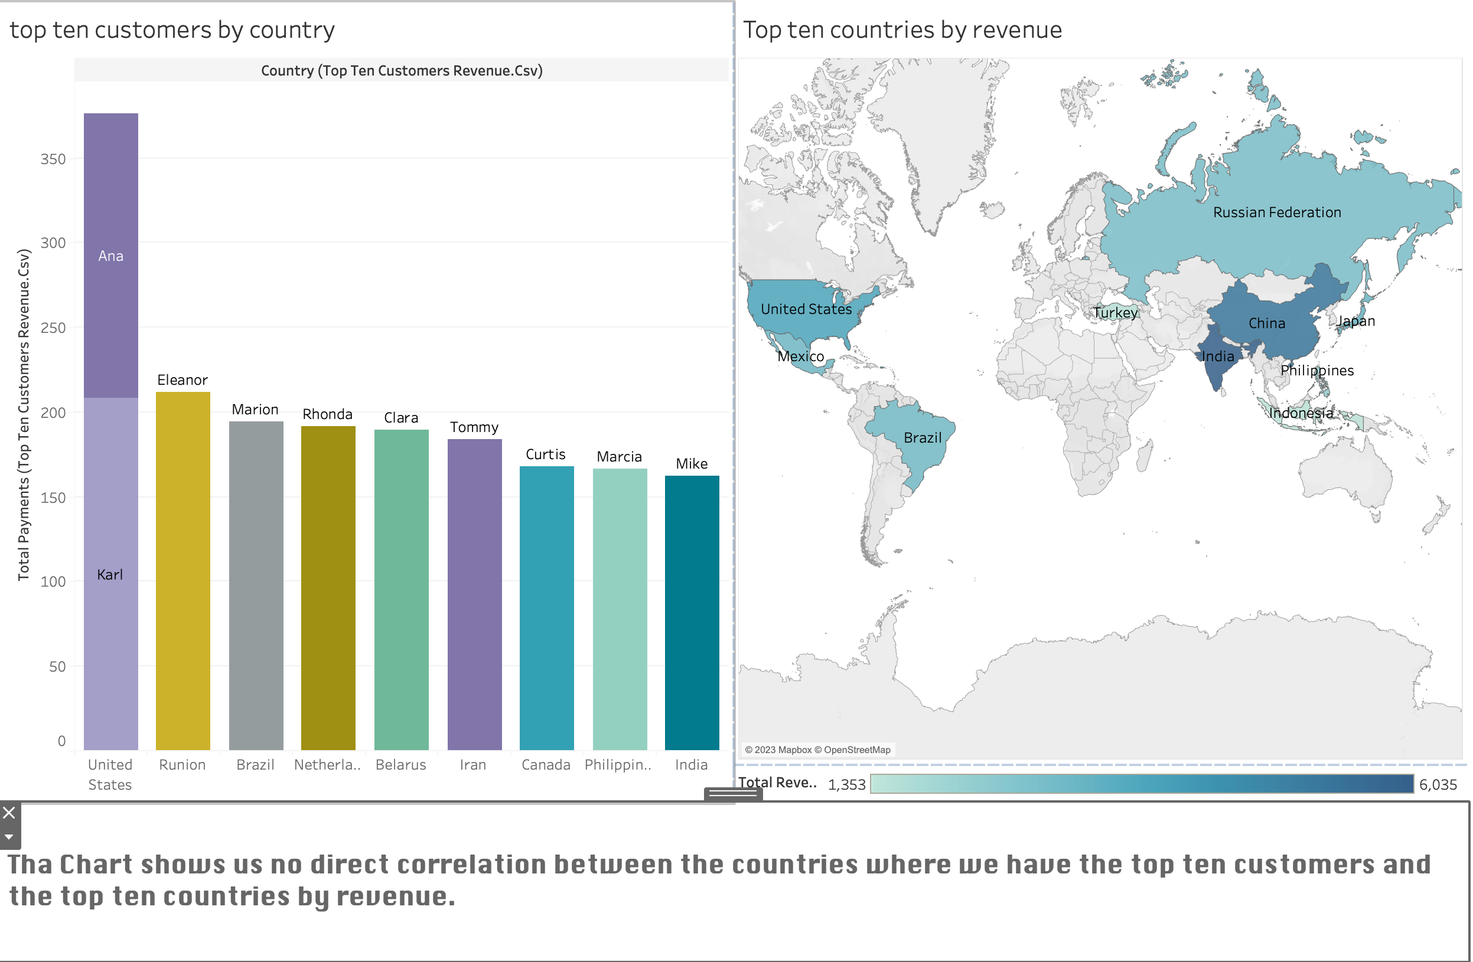

Slide 5
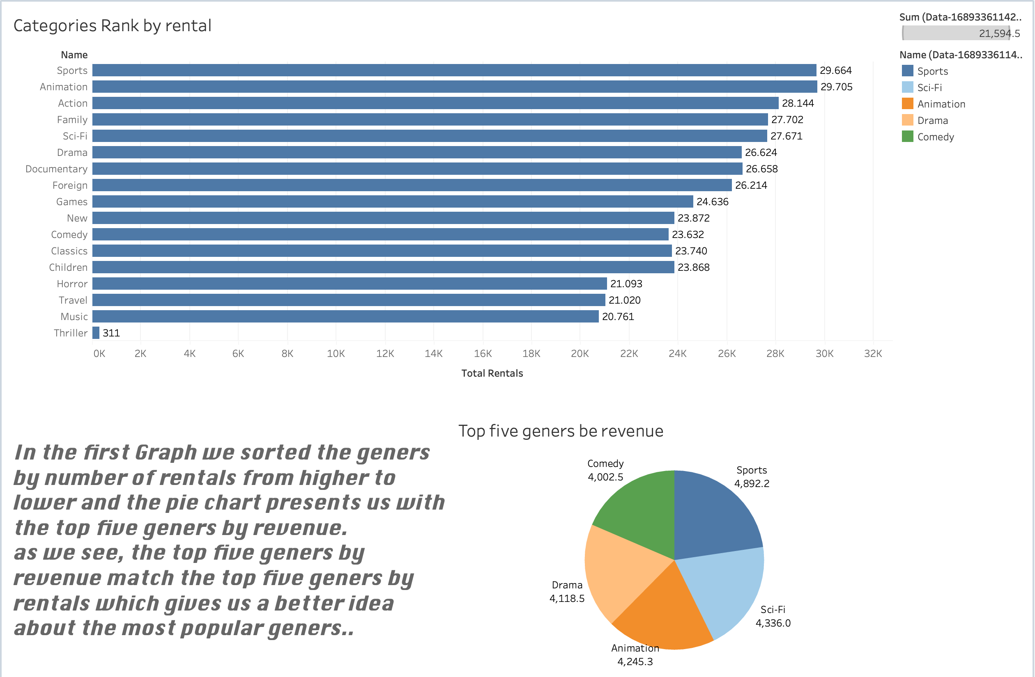

Slide 6
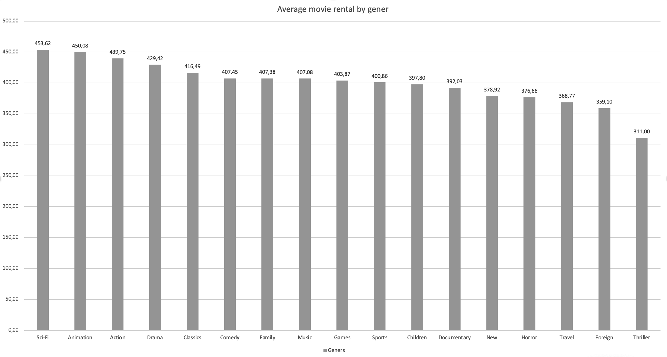
By trying to amplify our genre-based analysis we calculated the average rentals for each category by the number of movies that each category has. As we see in the graph the average rental is almost the same in all categories.

Slide 7

Summery: our analysis was based on analysing the custome behaviour across countries and geners.
Spatial analysis :
evaluating the countries by their revenues and amount of sales.
Gener based analysis:
comparing genres by revenue

Slide 8

See you next time where we will discuss the cost-benefit analysis.
Thank you for listining!
Tableau Story link:
https://public.tableau.com/app/profile/ghaleb.ju/viz/presentation-Ruckbuster3last/Story1?publish=yes

